Slide 1

Implementing new features in phpmyadmin
Swami Keshvanand Institute of Technology Management & Gramothan
Google Summer of Code 2017
Submitted to: Submitted by:
Mrs. Sushila Vishnoi Manish Bisht
Associate Professor 14ESKIT041

Slide 2
About phpmyadmin
phpMyAdmin is a free and open source software tool written in PHP, to handle the administration of MySQL over the Web.
phpMyAdmin supports a wide range of operations on MySQL and MariaDB. Frequently used operations (managing databases, tables, columns, relations, indexes, users, permissions, etc) can be performed via the user interface, while you still have the ability to directly execute any SQL statement

Slide 3
Preface
This presentation documents the work done during my summer internship in Google Summer of Code 2017 with the open source organisation phpmyadmin under the supervision of Isaac Bennetch. The presentation shall give an overview of the tasks completed during the period of internship with technical details. Further this presentation shall also give a brief description of the tools and environment that were used to create the project.
More Details: https://goo.gl/wHfQjS

Slide 4
Contents
Introduction …………………………………………………………………………………………. 1
About phpmyadmin……..……………………………………………………………………….. 2
Preface………………………………………………………………………………………………….. 3
Abstract ………………………………………………………………………………………………... 5
Implement Responsive/Mobile Design …………………………………………………. 6
JSON text field editor ……………………………………………………………………………. 7
Remove inline Javascript ………………………………………………………………………. 8
Disable double charset conversion during import ……………………………….. 9
Import/Export progress bar …………………………………………………………………. 10
Display tooltips in user permissions page ……………………………………………. 11
Set default configuration for phpmyadmin ………………………………………….. 12
Conclusion ………………………………………………………………………………………….. 13

Slide 5
Abstract
phpmyadmin has a large number of open issues (~210 at time of writing this). To maintain and improve phpmyadmin core project the numbers of issues should be lower down. This project aims to resolving the major issues and improvements to be done in phpmyadmin. I have selected a list of issues on which I will be working this summer.

Slide 6
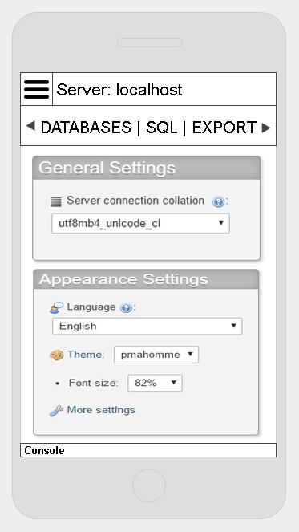
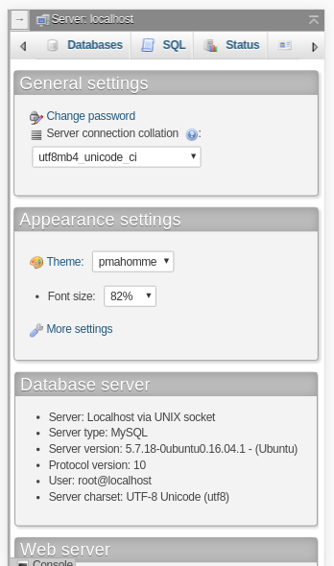
#1: Implement responsive/mobile interface
As the number of mobile users are increasing day by day so responsive design should be implemented into phpMyAdmin.
Proposed Design
Added Viewport
Used CSS Media Queries
30+ Pages
Fixed Tests Cases
Design
Result

Slide 7


#2: JSON text field editor
It will add the feature to have an easy view of the JSON data of a column of a table. Right now it shows in only one line, without any kind of format, so we can have an option to show when you are viewing a table with JSON data or when editing a nice JSON view.
Directly checking JSON fields
Using JSON.parse() for other fields

Slide 8
#3: Remove inline javascript
There are several places which uses inline javascript (like onclick, onsubmit and onchange). These should be removed and placed into javascript files. After removal we can get rid of 'unsafe-inline' for scripting in CSP.
Removed onmouseover
Removed onmouseout
Removed onmousedown
Removed onsubmit
Removed onchange
Removed onclick

Slide 9


#4: Disable charset conversion during import
If the import file is not in supported formats and it's not ‘utf-8’ then it runs the SET NAMES for the selected charset during the import option. So I will disable the second time encoding if the selected charset is same as that of the charset mentioned in the SET NAMES.

Slide 10
#5: Import/Export Progress bar
It would be really nice to have a progress bar showing import and export progress in real time in terms of percentage and having some more detailed information like which step/table it is processing.
For Export (export.php will be used)
Export Status in Percentage (including how many tables and rows have been already processed and which is in progress right now)
For Import (import.php will be used)
Upload a file and Unzip it. Import into a database (including how many tables and rows have been already processed and which is in progress right now)

Slide 11

#6: Display tooltips in user permissions page
When a user has access to a db (or table), but is not in the user table he's shown as not having a password. Even after successfully running the query delete from mysql.user where user = 'test' I was still able to login with the test account.
I will show the message “NO” without red mark and with showing an information icon with a tooltip saying that the user exists in some tables but not the user table.

Slide 12
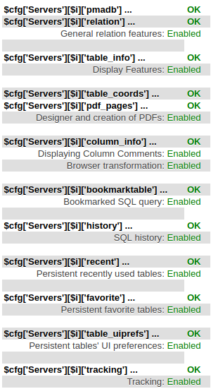
#7: Fallback to default table names
The PMA should fallback to default table names if controluser + pmadb options are set while other like 'relation', 'column_info' are NOT in config.inc.php.
So if the above conditions are matched I will make all features that are listed as Enabled instead of Disabled.

Slide 13
Conclusion
Through this comprehensive and an interesting project I got to know about how the organisation maintains the big project. I learnt the way of dealing with big projects from the developing phase to the testing phase. I have learnt lot of new things in Google Summer of Code 2017 with phpmyadmin.

Slide 14
Any Questions ?

Slide 15
Thank You !!

